Slide 1


Saad Berdaweel
04/03/2024

Slide 2

Outline
Executive Summary
Introduction
Methodology
Results
Conclusion
Appendix

Slide 3
Executive Summary
Methods Used
Data Collection
Data Cleaning
EDA with Data Visualization and SQL
Creating Interactive Maps
Predictive Analysis
Summary of all results
Exploratory Data Analysis Results
Interactive Analytics Findings
Predictive Analysis

Slide 4
Introduction
Space X is one of the largest companies that utilizes reusable rockets, esp. Falcon 9 rocket. Falcon 9 that costs around 62$ million to go on voyage to the International Space Station to provide Starlink satellite internet constellation that provides a fast internet connect. Other providers cost upwards of 165 % million. Much of Space X’s saving is due to the reusability of their rockets.
What we seek is that if we could determine if the first stage will land, we can determine the cost of the launch.

Slide 5

Section 1

Slide 6
Methodology
Executive Summary
Data collection methodology:
The data was collected from Space X’s website and Wikipedia’s site.
Perform data wrangling
Most of the data was clean already, so we checked for null values and transformed the outcome into One Hot Encoded representation (1, 0)
Perform exploratory data analysis (EDA) using visualization and SQL
Perform interactive visual analytics using Folium and Plotly Dash
Perform predictive analysis using classification models
Logistic Reg, KNN, SVM and Decision Tree had been built to evaluate the best classifier

Slide 7
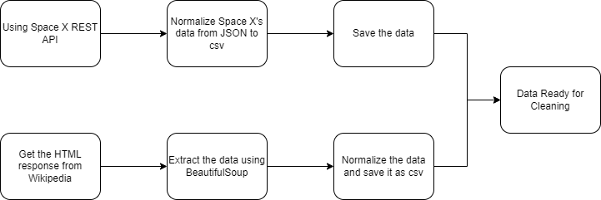
Data Collection
The dataset was collected as follows:
1- Gathered launch data from the SpaceX REST API
2- The API will provide data about launches, payload mass, landing outcome, etc.
3- In addition to utilizing a web scrapping tool, AKA Python library, called BeautifulSoup to scrape Wikipedia’s data of Falcon 9.
Space X REST API
Web Scraping

Slide 8
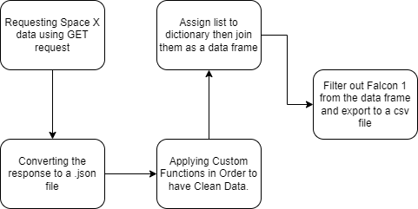
Data Collection – SpaceX API
Data Collection with Space X REST API calls
https://github.com/sethberdaweel/Portfolio-Projects/blob/main/IBM%20Capstone/Data%20Collection.ipynb

Slide 9
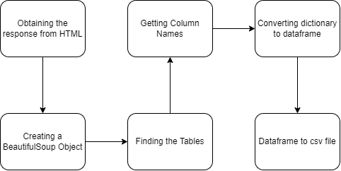
Data Collection - Scraping
Web Scrapping from Wikipedia
https://github.com/sethberdaweel/Portfolio-Projects/blob/main/IBM%20Data%20Science/Data%20Collection.ipynb

Slide 10
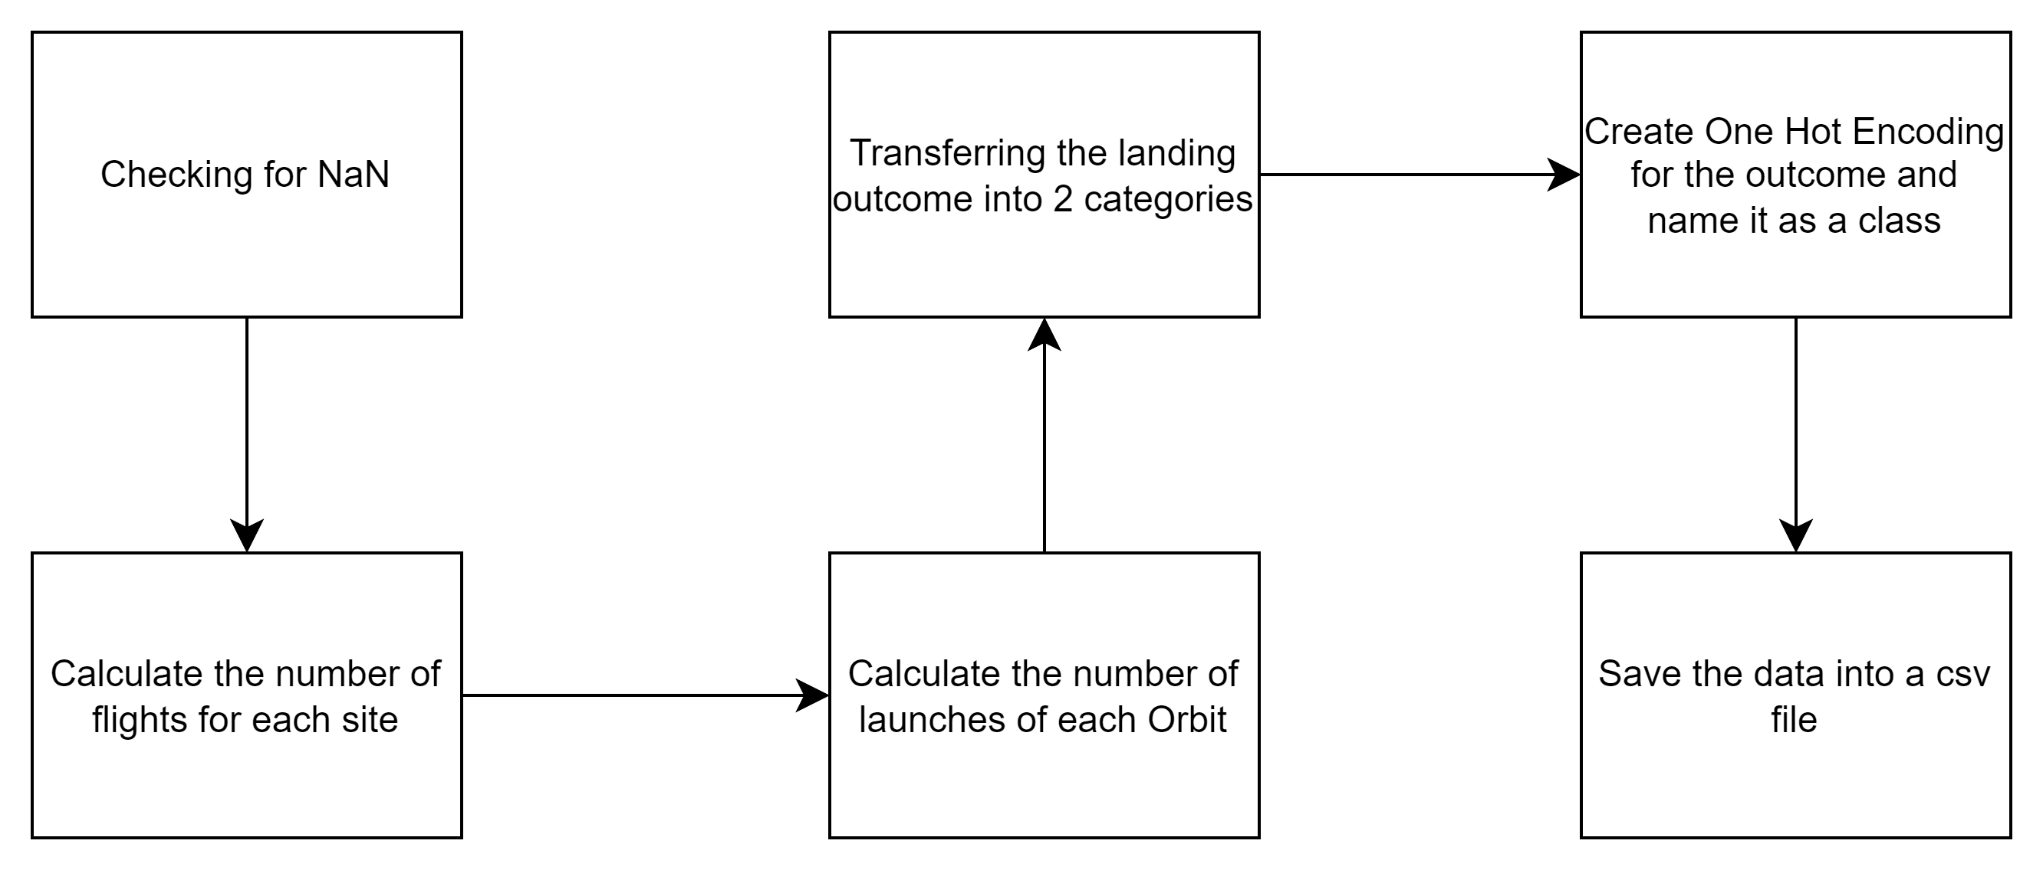
Data Wrangling
The data was checked for null values, calculated the number of flights of each launch site and each orbit. Then, we did One Hot Encoded and finally save it into a .csv file.
https://github.com/sethberdaweel/Portfolio-Projects/blob/main/IBM%20Data%20Science/Data_wrangling.ipynb

Slide 11
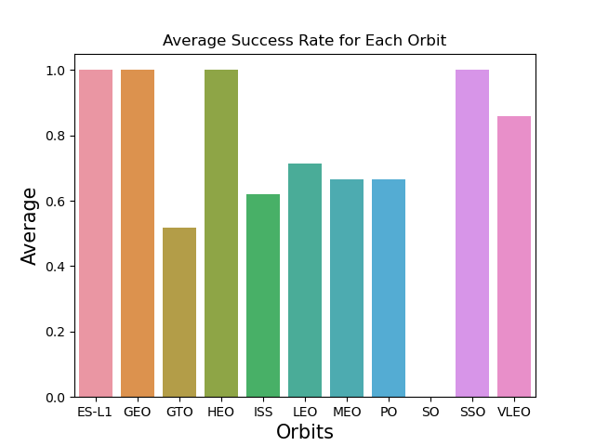
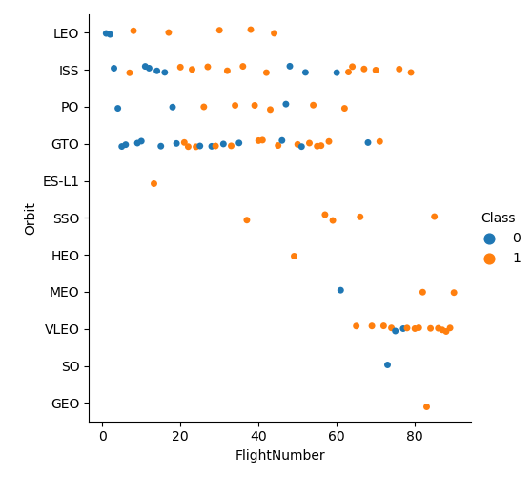
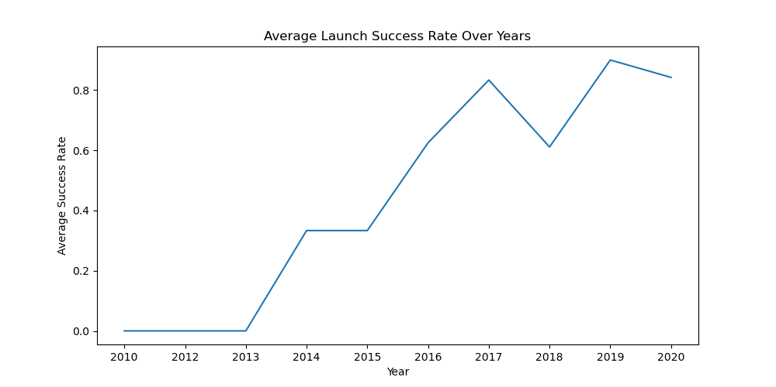
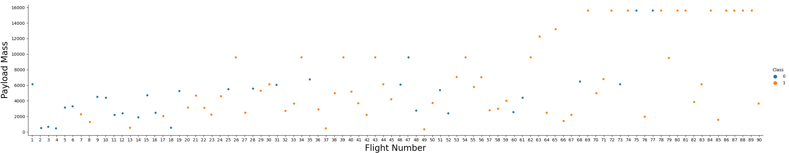
EDA with Data Visualization
https://github.com/sethberdaweel/Portfolio-Projects/blob/main/IBM%20Data%20Science/EDA_Vis.ipynb

Slide 12
EDA with SQL
SQL Queries Performed:
Displaying the names of the unique launch sites in the space mission.
Displaying 5 records where launch sites begin with the string ‘CCA’
Displaying the total payload mass carried by boosters launched by NASA (CRS)
Displaying average payload mass carried by booster version F9 v1.1
Listing the date where the successful landing outcome in ground pad was achieved
Listing names of boosters that had success in drone ship and have payload mass greater than 4000 but less than 6000.
Listing the total number of successful and failed mission outcomes.
Listing the names of the booster version that carried the maximum payload mass.
Listing the records which will display the month names and successful landing in drone ship, booster versions, launch site for the months in year 2015
Rank the count of landing outcomes (such as Failure(drone ship) or Success (ground pad)) between the date 2010-06-04 and 2017-03-20, in descending order
https://github.com/sethberdaweel/Portfolio-Projects/blob/main/IBM%20Data%20Science/EDA_SQL.ipynb

Slide 13
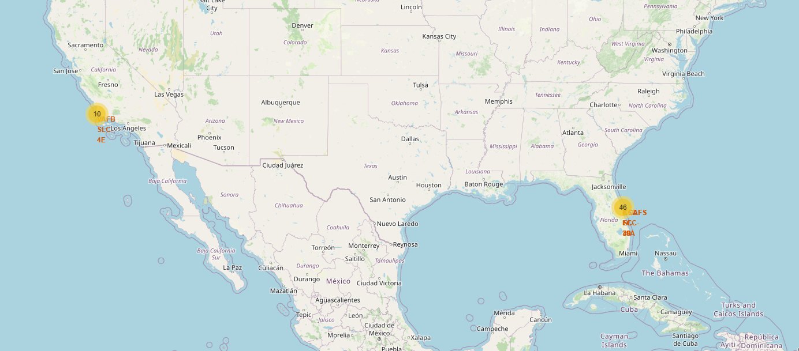
Build an Interactive Map with Folium
The aim of adding map markers to the map is to try to find the optimal location for building launch site
https://github.com/sethberdaweel/Portfolio-Projects/blob/main/IBM%20Data%20Science/Interactive_data_viz.ipynb

Slide 14
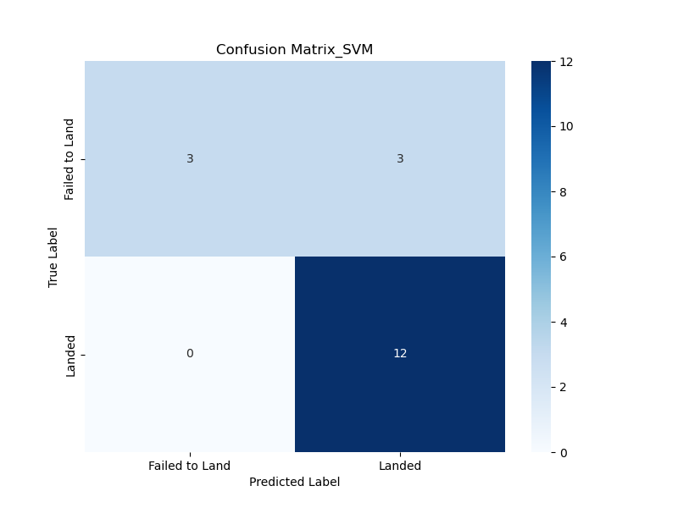

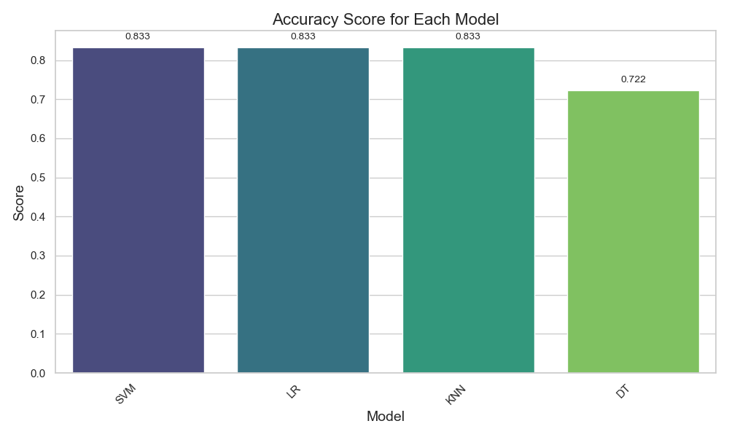
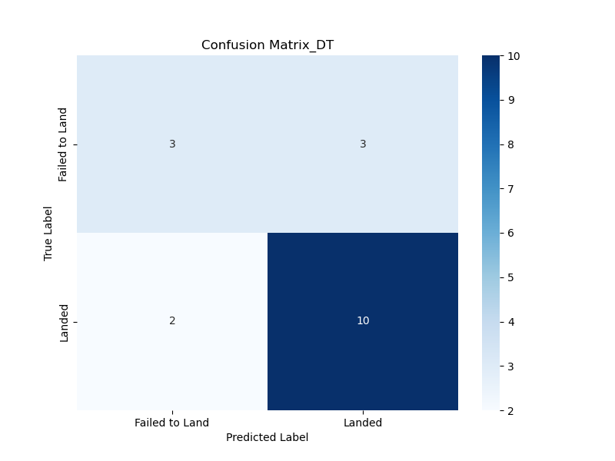

Predictive Analysis (Classification)
The SVM, KNN and Log Reg models achieved highest
of scores of 83.3%. DT has the accuracy of 72.2%.
https://github.com/sethberdaweel/Portfolio-Projects/blob/main/IBM%20Data%20Science/Modeling.ipynb

Slide 15
Results
Low weighted payloads perform much better than the heavier payloads.
GEO, ES-L1, HEO and SSO have the best success rate.
KSC LC 39A has the most successful launches from all the other sites.
The SVM, KNN and Logistic Regression models are the best in terms of prediction accuracy for the dataset.

Slide 16

Section 2

Slide 17
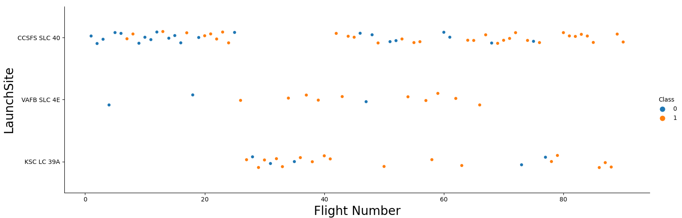
Flight Number vs. Launch Site
Launches from CCSFS SLC 40 site are immensely higher than launches from other sites.

Slide 18
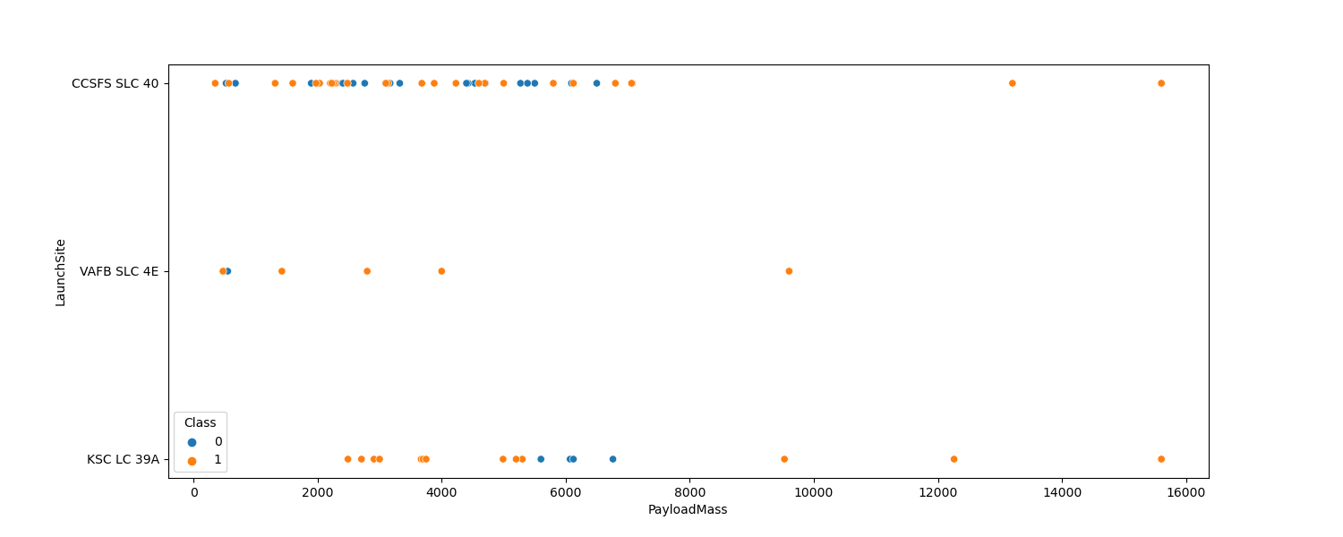
Payload vs. Launch Site
The payload mass of VAFB SLC 4E is somehow moderate, and it didn’t exceed 10,000 KG
Both KSC LC 39A and CCSFS SLC 40 held more payload mass.

Slide 19
Success Rate vs. Orbit Type
The orbits ES-L1, GEO, HEO and SSO have
the highest success rate.

Slide 20
Flight Number vs. Orbit Type
Though that the GEO and ES-L1 orbit has 100% success rates, but both had only one flight. So, I wouldn't consider them to be good indicators.
SSO is might be a good indicator, since it has 5 flights, with a 100% success rate.
The overall progress is evolving through the increasing of Flight Numbers.
Hence, LEO's success rate relates to the number of flight. As number of flight increased, the success rate increased.
And finally, There's no relation between flight number and GTO orbit.

Slide 21
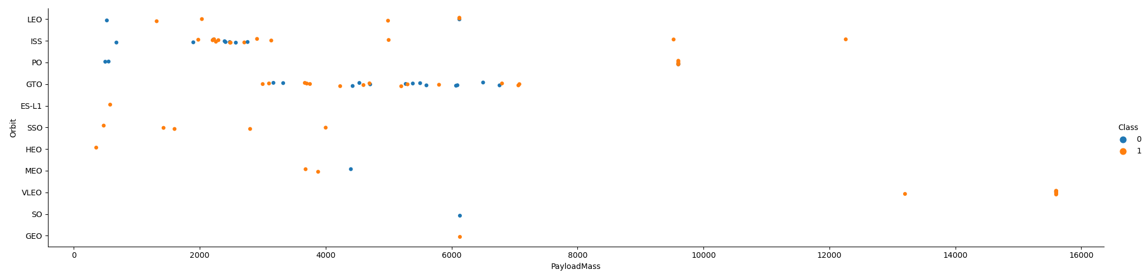
Payload vs. Orbit Type
With heavy Payload Mass, the successful landing rates are more for LEO, PO and ISS.

Slide 22
Launch Success Yearly Trend
Launch success rate kept increasing
since 2013 till 2020, with a slightly
downward trend in 2019.

Slide 23
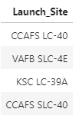
All Launch Site Names
%%sql SELECT DISTINCT(Launch_Site) FROM SPACEXTBL;

Slide 24
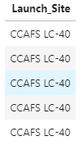
Launch Site Names Begin with 'CCA'
%%sql
SELECT Launch_Site
FROM SPACEXTBL
WHERE Launch_Site LIKE 'CCA%'
LIMIT 5;

Slide 25
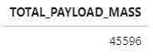
Total Payload Mass
%%sql
SELECT SUM(PAYLOAD_MASS__KG_) AS TOTAL_PAYLOAD_MASS
FROM SPACEXTBL
WHERE Customer = 'NASA (CRS)';

Slide 26
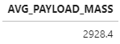
Average Payload Mass by F9 v1.1
%%sql
SELECT AVG(PAYLOAD_MASS__KG_) AS AVG_PAYLOAD_MASS
FROM SPACEXTBL
WHERE Booster_Version = 'F9 v1.1';

Slide 27
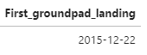
First Successful Ground Landing Date
%%sql
SELECT MIN(Date) AS First_groundpad_landing
FROM SPACEXTBL
WHERE Landing_Outcome = 'Success (ground pad)';

Slide 28
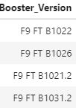
Successful Drone Ship Landing with Payload between 4000 and 6000
%%sql
SELECT DISTINCT(Booster_Version)
FROM SPACEXTBL
WHERE (PAYLOAD_MASS__KG_ BETWEEN 4000 AND 6000) AND Landing_Outcome = 'Success (drone ship)';

Slide 29
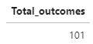
Total Number of Successful and Failure Mission Outcomes
%%sql
SELECT COUNT(Mission_Outcome) AS Total_outcomes
FROM SPACEXTBL;

Slide 30
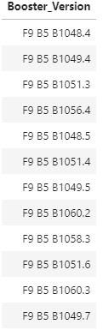
Boosters Carried Maximum Payload
%%sql
SELECT Booster_Version
FROM SPACEXTBL
WHERE PAYLOAD_MASS__KG_ = (SELECT MAX(PAYLOAD_MASS__KG_) FROM SPACEXTBL);

Slide 31
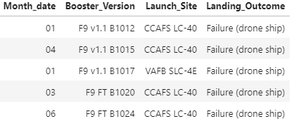
2015 Launch Records
%%sql
SELECT SUBSTR(Date, 6, 2) AS Month_date, Booster_Version, Launch_Site, Landing_Outcome
FROM SPACEXTBL
WHERE Landing_Outcome LIKE '%Failure%' AND Landing_Outcome LIKE '%drone%';

Slide 32
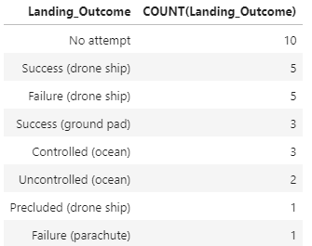
Rank Landing Outcomes Between 2010-06-04 and 2017-03-20
%%sql
SELECT Landing_Outcome, COUNT(Landing_Outcome)
FROM SPACEXTBL
WHERE SUBSTR(Date, 0, 12) > SUBSTR('2010-06-04', 0, 12) AND SUBSTR(Date, 0, 12) < SUBSTR('2017-03-20', 0, 12)
GROUP BY Landing_Outcome
ORDER BY COUNT(Landing_Outcome) DESC;

Slide 33

Section 3

Slide 34
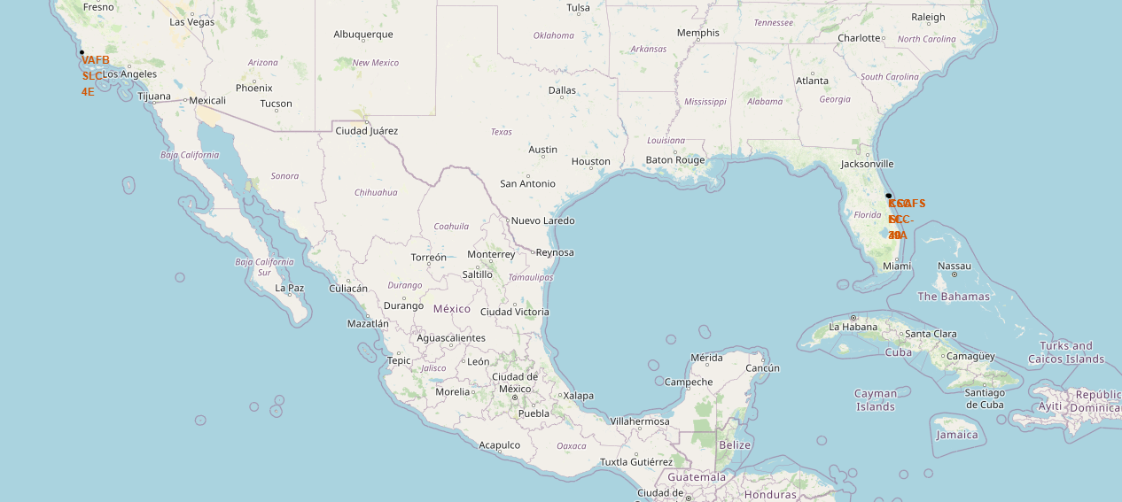
<Folium Map Screenshot 1>
Now we could notice that almost the 4 sites are in proximity to the equator line due to the need of utilizing the rotation speed of Earth
More on this in the appendices section.

Slide 35
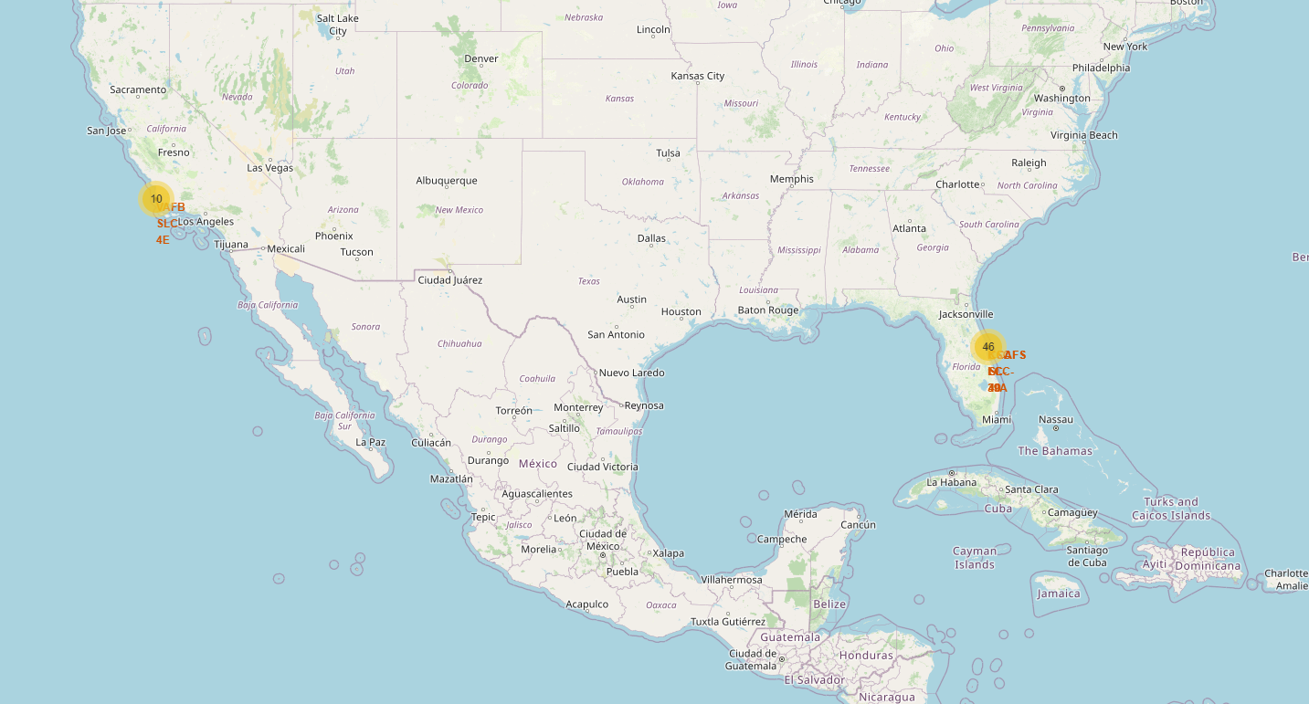
<Folium Map Screenshot 2>
We’d notice here that KSC LC-39A has the highest success rate among the four sites.

Slide 36

Section 4

Slide 37
Classification Accuracy
It’s evident through testing multiple models that KNN, Logistic Regression and SVM have the best accuracy. The Decision Tree didn’t perform much on the data.

Slide 38
Confusion Matrix
It wouldn’t differ much if you chose any of the three models (KNN, SVM and LR), so in a random choice, the logistic regression will do.

Slide 39
Conclusions
The SVM, KNN and LR models are the best in terms of accuracy.
Low weighted payloads perform better than heavier payloads.
The success rate for Space X launches has increased through the time, indicating that down the road more launches will perfectly land.
KSC LC-39A has the most successful launches among other sites.
Orbits GEO, HEO, SSO and ES L1 have the best success rate.

Slide 40
Appendix
we could notice that almost the 4 sites are in proximity to the equator line due to the need of utilizing the rotation speed of Earth.
This is due to the fact that the Earth rotates on its axis, and at the equator, the rotational speed is higher than at higher latitudes.
We could also notice that all of SpaceX launch sites are in proximity to coast.
This relates to multiple reasons, safety and overflight clearance is one of those reasons. Emergency Abort Scenarios is a second reason to consider for the launch sites being close to the coast.

Slide 41
Appendix
For the most success rate of the orbits, I’d argue the following:
We couldn’t conclude that GEO and ES L1 should be taken as a measure.
Since they only had one flight, which is hard to jump into conclusions predicating on the aforementioned.
In conclusion, I wouldn’t take them as good indicators.

Slide 42


